Slide 1
Sampling based Motion Planning Implementation & Variation
20193300
Hyunki Seong

Slide 2
Contents
Motivation
Autonomous Robotic Exploration Based on Multiple Rapidly-exploring Randomized Trees (IROS, 2017)
Fast Marching Tree: A fast marching sampling-based method for optimal motion planning in many dimensions (IJRR, 2015)
Recap

Slide 3
1. Motivation

Slide 4
Motivation - Sampling-based Planning
Implementation: [Autonomous Robotic Exploration Based on Multiple Rapidly-exploring Randomized Trees]
Variation: [Fast Marching Tree: A fast marching sampling-based method for optimal motion planning in many dimensions]
RRT + Exploration
Implementation based on ROS framework
Optimal sampling-based motion planning algorithm
Faster convergence to an optimal solution than RRT*, PRM*
Notes:
My goal in this lecture : Learning sampling based motion planning. (efficient in high dimension env. MANY paper RRT variation)
I hope to introduce to you

Slide 5
2. Autonomous Robotic Exploration Based on Multiple Rapidly-exploring Randomized Trees [RRT Exploration]
Key features
Methodology
Implementation
Conclusion

Slide 6
2. RRT Exploration
Key features
RRT + Exploration
Frontier points for exploration
RRT based Local + Global detector
Task allocator for exploration
2D lidar, Differential mobile robot
Implementation based on ROS framework
Reference: Hassan Umari, Autonomous robotic exploration based on multiple rapidly-exploring randomized trees (IROS 2017)

Slide 7
2. RRT Exploration
Methodology – Overall algorithm
RRT-based
Frontier detector module
Filter module
Task allocator module
“Detecting frontier points”
“Clustering the frontier points”
“Assigning a target point”
- Overall schematic diagram of the exploration algorithm -
Reference: Hassan Umari, Autonomous robotic exploration based on multiple rapidly-exploring randomized trees (IROS 2017)
Notes:
나중에
So our question is, why they use RRT?

Slide 8
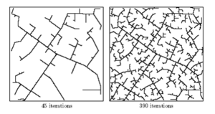
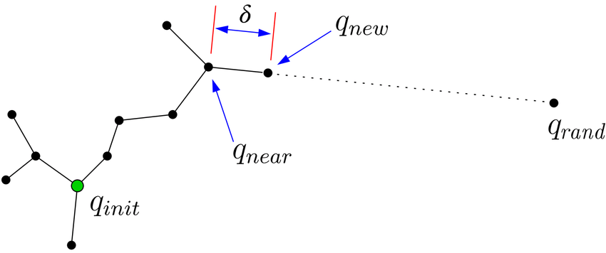
2. RRT Exploration
Methodology – Rapidly-exploring Random Tree
- Visualization of RRT graphs -
- Pseudo-code of RRT -
Reference: Hassan Umari, Autonomous robotic exploration based on multiple rapidly-exploring randomized trees (IROS 2017)

Slide 9
2. RRT Exploration
Methodology – Frontier Detector
“Frontier points: Candidates of target point for exploration”
→ x is a Frontier point
→ keep growing tree
GridCheck == -1 : unknown area / 1 : known area
The Global Frontier Detector is identical to the Local Detector except line 8
(No reset. Keep growing tree)
- RRT for detecting frontier points -
Reference: Hassan Umari, Autonomous robotic exploration based on multiple rapidly-exploring randomized trees (IROS 2017)

Slide 10
2. RRT Exploration
Methodology – Frontier Detector
Local detector
Pros: Allow detection of frontier points quicker
Cons: Hard to detect points far from robot
Global detector
Pros: Make sure to detect points which are far from robot
Cons: Bigger tree, Slower exploring (num. of tree vertices increase)
“Complement one another so that frontier detection is as fast as possible.”
- RRT for detecting frontier points -
Reference: Hassan Umari, Autonomous robotic exploration based on multiple rapidly-exploring randomized trees (IROS 2017)

Slide 11
2. RRT Exploration
Methodology –Task allocator
Considering
Navigation cost (N)
Expected distance from robot to a frontier point
Information gain (I)
Num. of unknown cells surrounding a frontier point
Revenue from a frontier point (R)
→ hysteresis gain (based on user experience)
- I gain region of a frontier point -
→ h > 1 so that the robot is biased to explore
Reference: Hassan Umari, Autonomous robotic exploration based on multiple rapidly-exploring randomized trees (IROS 2017)

Slide 12
2. RRT Exploration
Methodology – Overall procedure
- Propagation of the local RRT and the detection of frontier points -
Reference: Hassan Umari, Autonomous robotic exploration based on multiple rapidly-exploring randomized trees (IROS 2017)

Slide 13
2. RRT Exploration
Implementation
- RRT map exploration -
Reference: Hassan Umari, Autonomous robotic exploration based on multiple rapidly-exploring randomized trees (IROS 2017)

Slide 14
2. RRT Exploration
Conclusion
Summery
Combine RRT property with Exploration
RRT based Local + Global Frontier point detector
Task allocator for the target position of exploration
ROS based implementation
Expectation
Pros: Utilize RRT property + Global & Local Frontier detector
Pros: Customized Task allocator for specific task (Not only for mapping)
Cons: 2D SLAM, Differential robot model Only
Reference: Hassan Umari, Autonomous robotic exploration based on multiple rapidly-exploring randomized trees (IROS 2017)

Slide 15
3. Fast Marching Tree: A fast marching sampling-based method for optimal motion planning in many dimensions [Fast Marching Tree]
Key features
Methodology
Properties (A.O., Convergence rate)
Results
Conclusion

Slide 16
3. Fast Marching Tree
Key features
Optimal sampling-based motion planning
Faster convergence to an optimal solution than RRT*, PRM*
“Lazily” ignore collision, and whenever a locally-optimal connection intersects an obstacle, it is simply skipped & left for later =>Such suboptimal connections become rare as the number of samples goes to infinity (Asymptotic Optimality (A.O.))
Formulate the “first” theoretic convergence rate bound for optimal sampling-based motion planning algorithm
- The growth of the Fast Marching Tree in a 2D environment -
Reference: Lukas Janson, Fast Marching Tree: A fast marching sampling-based method for optimal motion planning in many dimensions (IJRR 2015)

Slide 17
(line 5) Lazily skip collision checking
(line 6) Collision checking AFTER locally optimal one-step connection
Reference: Lukas Janson, Fast Marching Tree: A fast marching sampling-based method for optimal motion planning in many dimensions (IJRR 2015)

Slide 18
3. Fast Marching Tree
Properties – Asymptotic Optimality (A.O.)
Reference: Lukas Janson, Fast Marching Tree: A fast marching sampling-based method for optimal motion planning in many dimensions (IJRR 2015)

Slide 19
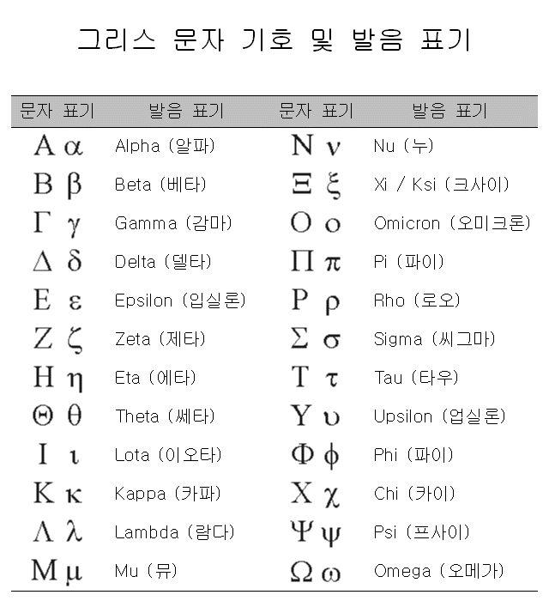
3. Fast Marching Tree
Properties – Convergence rate
If $η=1$ (Eta), Convergence rate bounds $O(n^{−\frac{1}{d}+ρ})$
Rate of convergence increases as $η$ increases
The amount of computation per sample increases as $η$ increases
Reference: Lukas Janson, Fast Marching Tree: A fast marching sampling-based method for optimal motion planning in many dimensions (IJRR 2015)

Slide 20
3. Fast Marching Tree
Results
OMPL “bug trap” Env
Solution Cost
Success Rate
Execution Time [sec]
Collision Checks
Reference: Lukas Janson, Fast Marching Tree: A fast marching sampling-based method for optimal motion planning in many dimensions (IJRR 2015)

Slide 21
3. Fast Marching Tree
Results
OMPL “Maze” Env
Solution Cost
Success Rate
Execution Time [sec]
Collision Checks
Reference: Lukas Janson, Fast Marching Tree: A fast marching sampling-based method for optimal motion planning in many dimensions (IJRR 2015)

Slide 22
3. Fast Marching Tree
Results
OMPL “Alpha puzzle” Env
Solution Cost
Success Rate
Execution Time [sec]
Collision Checks
Reference: Lukas Janson, Fast Marching Tree: A fast marching sampling-based method for optimal motion planning in many dimensions (IJRR 2015)

Slide 23
3. Fast Marching Tree
Conclusion
Summery
Optimal sampling-based motion planning
Faster convergence to an optimal solution than RRT*, PRM* (“Lazily” collision checking)
Suboptimal connections become rare as the number of samples goes to infinity (A.O.)
Formulate the “first” theoretic convergence rate bound for optimal sampling-based motion planning algorithm
Expectation
Pros: Fast Optimal motion planner
Cons: No implementation in Real-world robot yet
Reference: Lukas Janson, Fast Marching Tree: A fast marching sampling-based method for optimal motion planning in many dimensions (IJRR 2015)

Slide 24
4. Recap

Slide 25
4. Recap
RRT Exploration
Combine RRT property with Exploration
RRT based Local + Global Frontier point detector
Task allocator for the target position of exploration
ROS based implementation
Fast Marching Tree
Optimal sampling-based motion planning
Faster convergence to an optimal solution than RRT*, PRM*
Formulate the “first” theoretic convergence rate bound for optimal sampling-based motion planning algorithm
Reference: Hassan Umari, Autonomous robotic exploration based on multiple rapidly-exploring randomized trees (IROS 2017)
Reference: Lukas Janson, Fast Marching Tree: A fast marching sampling-based method for optimal motion planning in many dimensions (IJRR 2015)

Slide 26
Q & A

